Slide 1
Engineering Challenges in ev safety
Team
Abhishek Mishra(IIT ISM, Mechanical Engineering)
Abhishek Prakash(IIT ISM, Electronics and communication engineering)
Ayush Agrawal(IIT ism, electronics and communication engineering)

Slide 2
contents
Fires Involving EV vehicles worldwide
EV fires In India
Market Leaders in Battery Management System(BMS)
Charging stations-suppliers
Risk Concerns
Correlation of technology with published literature
References

Slide 3
Fires Involving EV vehicles Worldwide
Some Documented Incidents worldwide that caught attention are highlighted in the table below.(Table 1.1)
Year | Location | Vehicle | Incident | Cause | Comments
2011 | Wisconsin, USA | Chevrolet Volt | Fire 3 weeks after crash test. | Leaking coolant in battery. | The delayed fire incident was also reproduced.
2011 | Hangzhou, China | Zotye M300 EV | Fire while driving. |  | All battery taxis were pulled off the street temporarily.
2012 | Sweden | Rebuilt Fiat 500 | Fire during charging(after 25 hrs) | Fire started in engine compartment, probabily heater.
2013 | Paris, France | 2 Bollore Bluecar | Fire in parked vehicle and spread to second vehicle. | Maybe vandalism, but not sure.

Slide 4
Year | Location | Vehicle | Incident | Cause | Comments
2013 | Japan | Mitsubishi Outlander PHEV | A few battery heating incidents. |  | Production was shut down for 5 months.
2013 | Mexico, USA | 3 Tesla Model S | 3 different fires within 6 weeks. | Hitting road debris and concrete wall(and tree). | Tesla reinforced the construction.
2014 | Toronto, Canada | Tesla Model S | Fire in garage. |  | Four months old, not plugged in.
2016 | Oslo, Norway | Tesla Model S | Fire when plugged to Tesla Supercharger station. | Short circuit in electrical system of the car.
2017 | Essex, UK | Smart ForTwo ED | Fire during Charging | Electrical Fault
2018 | Bangkok, Thailand | Porsche Panamera | Fire while being charged, spread to home |  | Car’s charging cable plugged to socket in living room.

Slide 5
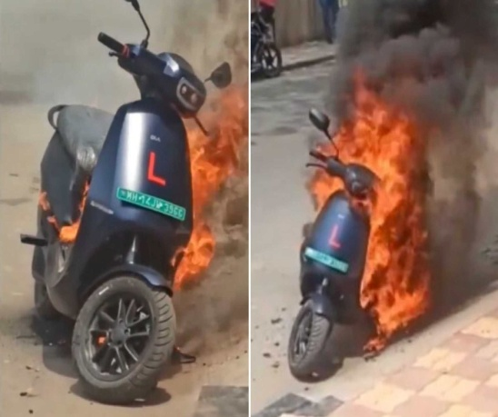
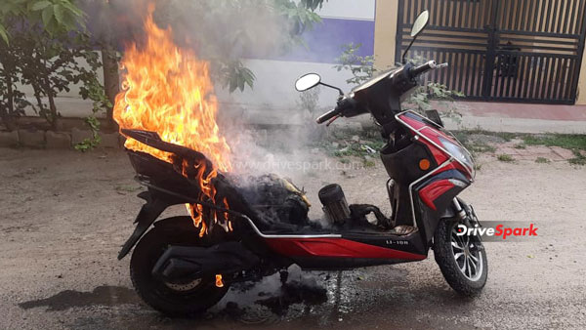
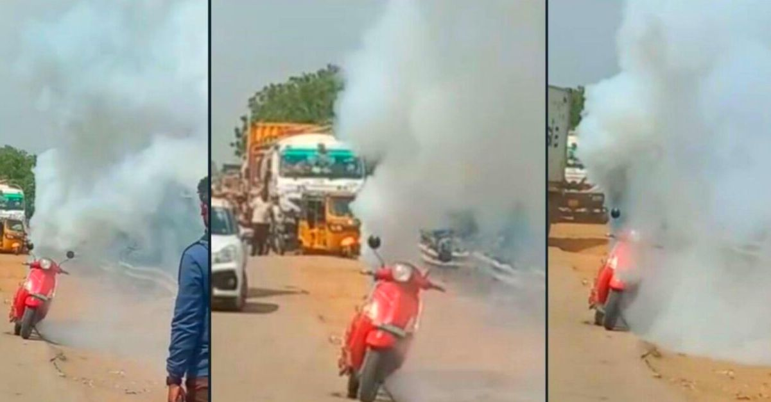
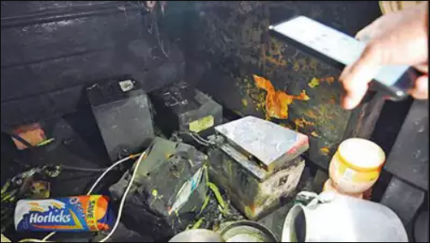
EV fires in India[a]
Some incidents that were in limelight this year(2022).
Ola S1 pro electric scooter caught fire in Pune, Maharashtra.
Okinawa electric scooter caught fire in Vellore, Tamil Nadu.
Pure EV scooter caught fire in Chennai, Tamil Nadu.
EV 2 wheeler battery(belonging to battery firm HCD based in Gurugram) explosion in Gurugram, Haryana.
The causes have yet not been revealed but most probably these fires were caused due to negligence in charging and short circuits in electrical systems.

Slide 6
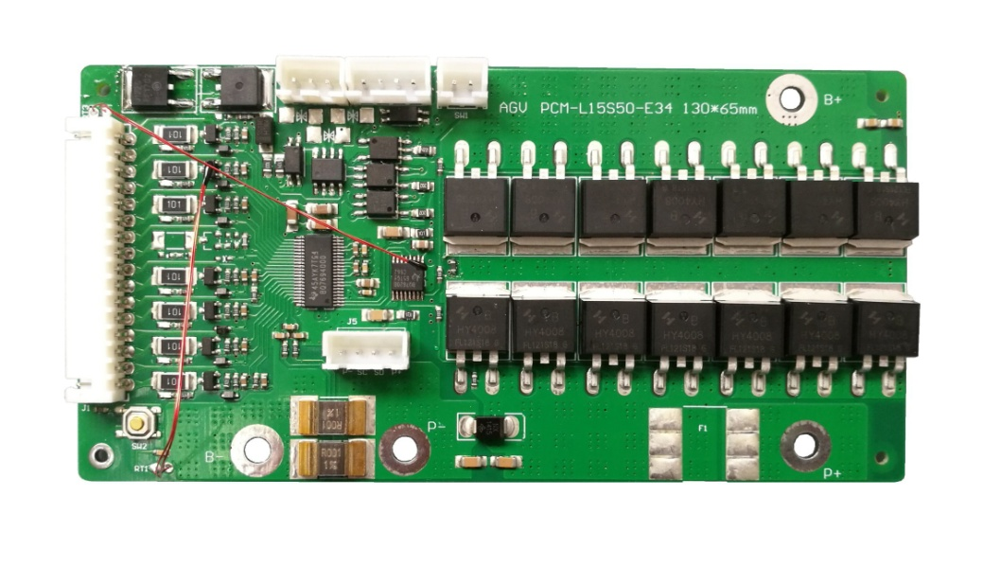
Market leaders in battery management system(BMS)
What is BMS?[b]
A battery management system (BMS) is any electronic system that manages a rechargeable battery by protecting the battery from operating outside its safe operating area monitoring its state, calculating secondary data, reporting that data, controlling its environment, authenticating it and balancing it.

Slide 7






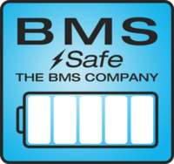

Market leaders[c]

Slide 8
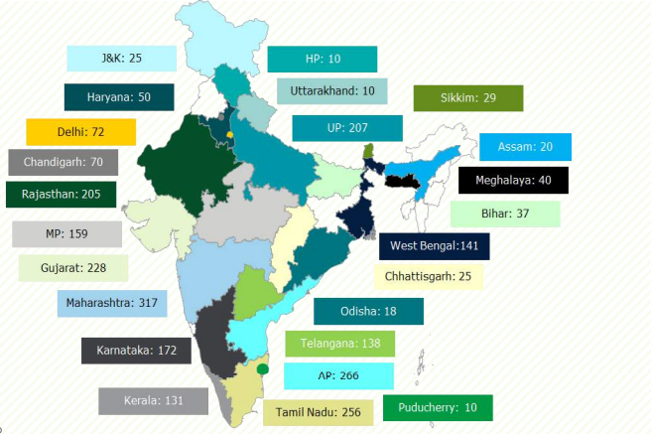
Charging stations- suppliers
INDIA[d]
In India, 2636 charging stations are proposed in which there are 1633 fast charging station and 1003 slow charging station.
State wise distribution of charging stations in India.
Charging stations are categorized in three
groups :-
Level 1 ac charging ( 6- 10 hours)
Level 2 ac charging (1-3 hours)
Level 3 dc charging (30 minutes)

Slide 9











Major players are
Global leaders[e] :-
Indian market leaders[f]:-

Slide 10
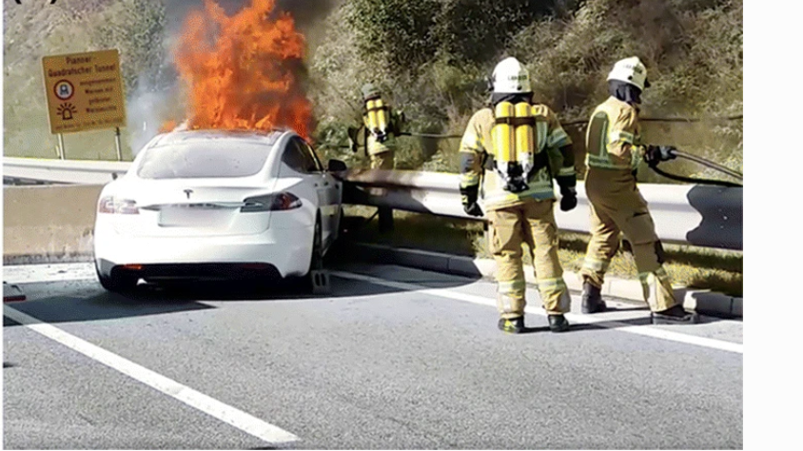
Risk Concern[g]
In Mobility
>Batteries may exceed their safe operating temperature.
>Accidents may increase as EVs produce less sound.
>Due to accidents lithium ion battery may combust and cause thermal runaway.
>Due to uneven roads Vibration can cause damage to battery and reduce its affective life.
In Idle condition
>In cold temperatures, the battery’s internal resistance increases.
>In high-temperature conditions, some unwanted chemical reactions can occur and result in overheated batteries.
>water leakage can cause short circuit.
Tesla Model S crashed on a concrete construction barrier in Austria at high speed and started a fire.[g]

Slide 11
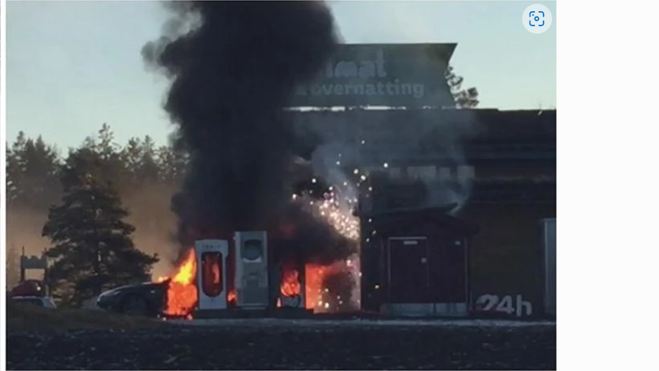
During charging
>Due to overcharging of batteries.
>faulty charging equipment.
>fast charging can reduce battery life.
Environmental Impact
>no standardized procedure to recycle lithium ion batteries.
>During battery fire it releases harmful gases like CO, NO, SO₂, HCl, and HF.
The fire on a Tesla Model S while being charged at the supercharging station in Norway on 1 January 2016, where the fire also spread to the passenger compartment.[g]

Slide 12
Correlation of technology with published literature
Inherent safety methods(preventing thermal runaway[h])
>>coating of cathode and anode with certain materials can increase thermal stability.
>>mixing electrolyte with safety protection agent, which includes flame/fire retardant additive and overcharge additive.
Safety designs
>> The safety design for lithium ion battery is finding a way to release high pressure and heat before thermal runaway.
>> Based on this ideal, safety vents, thermal fuse, positive temperature coefficient (PTC), shutdown separators and special battery management system (BMS) be developed for battery packs.
Alternative of lithium ion batteries[i]
>>using capacitors for storing energy in electrostatic form rather than chemical. It is far more safe then lithium ion batteries. China is using it currently in city buses known as capabus.

Slide 13
7.REFERENCES
Table 1.1 - https://www.researchgate.net/publication/336640117_Fire_Safety_of_Lithium-Ion_Batteries_in_Road_Vehicles
[a] EV fires in India - https://timesofindia.indiatimes.com/business/india-business/from-ola-electric-to-okinawa-scooters-why-electric-vehicles-have-been-catching-fire-in-india/articleshow/90857803.cms | https://timesofindia.indiatimes.com/city/gurgaon/60-year-old-dies-as-e-bike-battery-on-charge-explodes-causes-fire/articleshow/88349374.cms
[b] Battery management system – Wikipedia
[c] Battery Management System Market: Global Industry Analysis 2027 (maximizemarketresearch.com)
[d] FullReport_Status_quo_analysis_of_various_segments_of_electric_mobility-compressed (2).pdf
[e] Top 10 EV Charging Station Companies You Should Know – Rx Mechanic
[f] List of Top EV Charging Solution Providers in India • Evreporter
[g] Figure 10 | A Review of Battery Fires in Electric Vehicles | SpringerLink
[h] Thermal runaway caused fire and explosion of lithium ion battery – ScienceDirect
[i] Capacitor electric vehicle - Wikipedia

Slide 14


